Slide 1

KALINGA INSTITUTE OF INDUSTRIAL TECHNOLOGY
Data Structures and Algorithms (CS-2001)
School of Computer Engineering
Strictly for internal circulation (within KIIT) and reference only. Not for outside circulation without permission
4 Credit
Lecture Note

Slide 2

Chapter Contents
2
Sr # | Major and Detailed Coverage Area | Hrs
6 | Graphs | 5
 | Graph ADT, Graph Operation – DFS, BFS

Slide 3
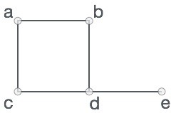
Introduction
3
A graph is a representation of a set of objects where some pairs of objects are connected by links. The interconnected objects are represented by points termed as vertices, and the links that connect the vertices are called edges. Formally, a graph is a pair of sets (V, E), where V is the set of vertices and E is the set of edges, connecting the pairs of vertices. Take a look at the following graph −
In the above graph, V = {a, b, c, d, e}
E = {(a,b), (a,c), (b,d), (c,d), (d,e)}

Slide 4
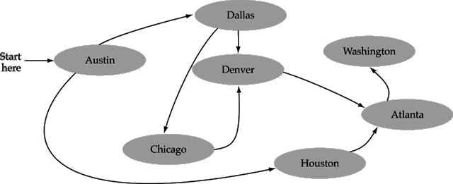

Formal Definition
4
A graph G is defined as follows:
G = (V, E)
V(G): a finite, nonempty set of vertices
E(G): a set of edges (pairs of vertices)
Class Work
Define V(G) and E(G) of the above graph

Slide 5
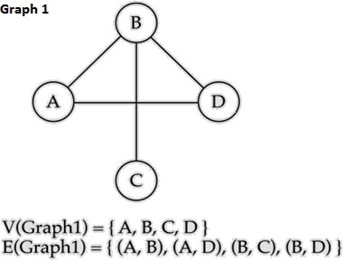
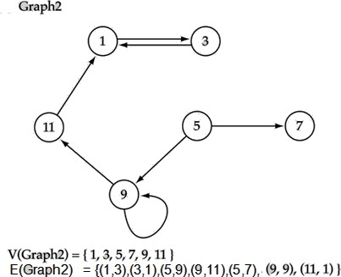
Directed and Undirected Graph
5
Undirected Graph
Directed Graph
When the edges in a graph have no direction, the graph is called undirected
When the edges in a graph have a direction, the graph is called directed (or digraph)

Slide 6
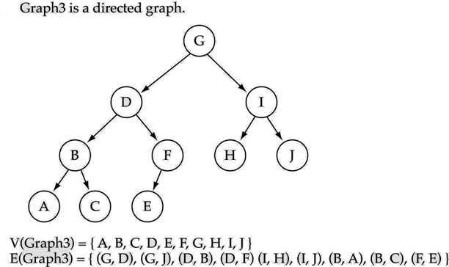
Trees vs. Graphs
6
Trees are special cases of graphs!!

Slide 7
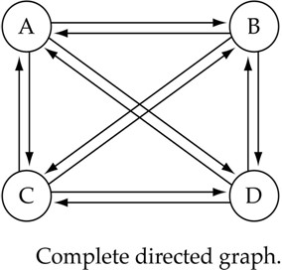
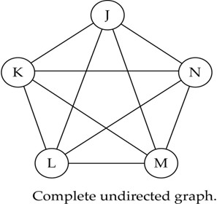
Graph Terminology
7
Adjacent nodes: two nodes are adjacent if they are connected by an edge
5 7
5 is adjacent to 7
7 is adjacent from 5
Path: a sequence of vertices that connect two nodes in a graph
Complete graph: a graph in which every vertex is directly connected to every other vertex
What is the number of edges in a complete directed graph with N vertices?
What is the number of edges in a complete undirected graph with N vertices?

Slide 8
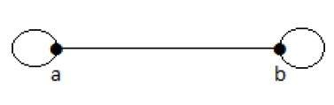
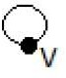
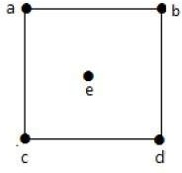
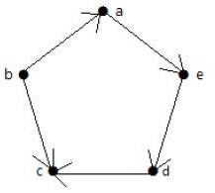
Graph Terminology cont…
8
Loop: In a graph, if an edge is drawn from vertex to itself, it is called a loop.
Degree of Vertex: The degree of a graph vertex of a graph is the number of graph edges which touch.
Degree of vertex in undirected graph
Degree of vertex in directed graph
Each vertex has an indegree and an outdegree. Indegree of vertex V is the number of edges which are coming into the vertex V. Outdegree of vertex V is the number of edges which are going out from the vertex V.
Vertex | Indegree | Outdegree
a | 1 | 1
b | 0 | 2
c | 2 | 0
d | 1 | 1
e | 1 | 1
deg(a) = 2, deg(b) = 2, deg(c) = 2, deg(d) = 2, and deg(e) = 0

Slide 9
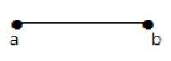
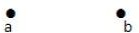
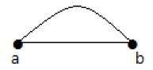
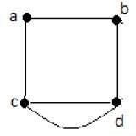
Graph Terminology cont…
9
Pendent Vertex: A vertex with degree one is called a pendent vertex.
Isolated Vertex: A vertex with degree zero is called an isolated vertex.
Parallel Edges: In a graph, if a pair of vertices is connected by more than one edge, then those edges are called parallel edges.
Multi Graph: A graph having parallel edges is known as a Multigraph.

Slide 10
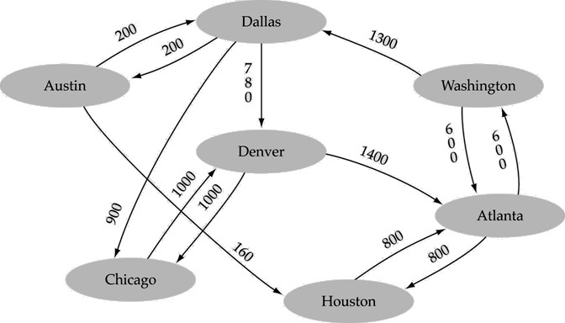
Graph Terminology cont…
10
Weighted graph: a graph in which each edge carries a value

Slide 11
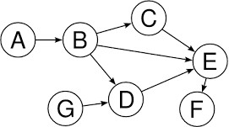
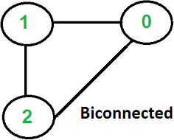
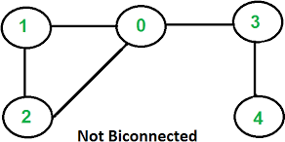
Graph Terminology cont…
11
Directed Acyclic graph: a direct graph with no cycles
Bi-connected graph: It is a connected graph which cannot be broken down into any
further pieces by deletion of any single vertex and incident edges.

Slide 12
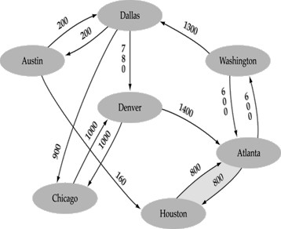
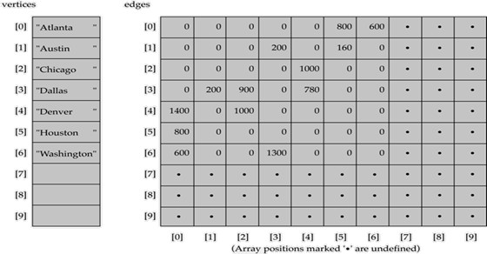
Representing Graphs in Memory
12
Let G be the graph. There are 2 ways of representing it in memory. The first way is called the link representation of G and the second way which uses arrays is called the sequential representation of G.
Sequential Representation (Array based)
A 1D array is used to represent the vertices
A 2D array (adjacency matrix) is used to represent the edges

Slide 13
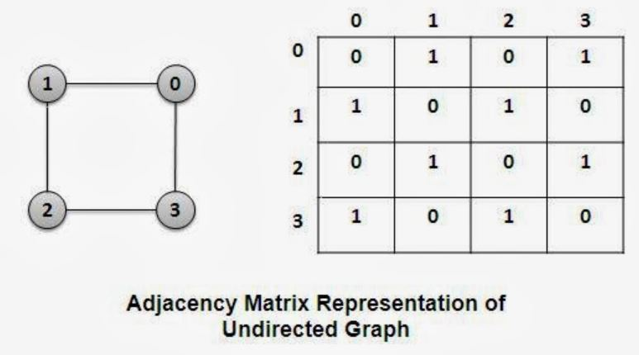
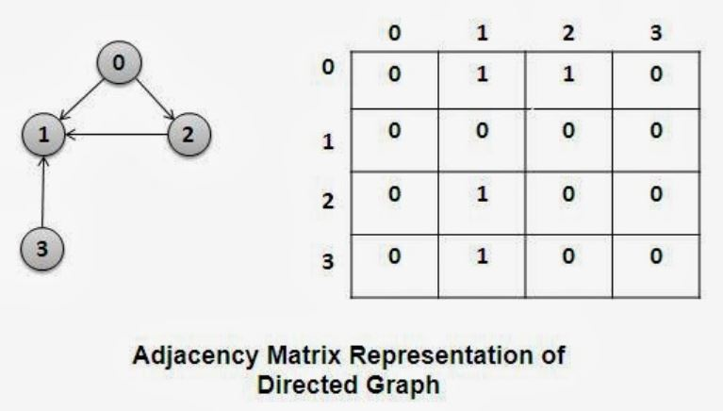
Graph Terminology cont…
11

Slide 14

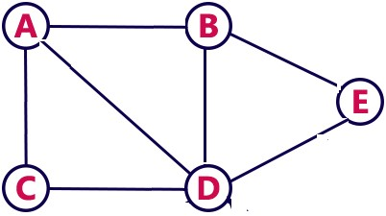
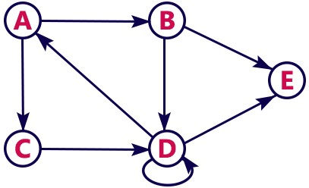
Class Work
13
Let G be the unweighted undirected graph with 5 vertices. Represent it using Adjacency Matrix
Let G’ be the unweighted directed graph with 5 vertices. Represent it using Adjacency Matrix

Slide 15
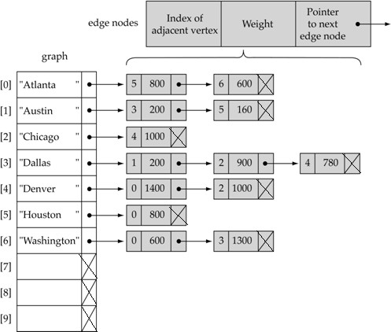

Linked Representation of Graph
14
A 1D array is used to represent the vertices
A list is used for each vertex v which contains the vertices which are adjacent from v (adjacency list)

Slide 16
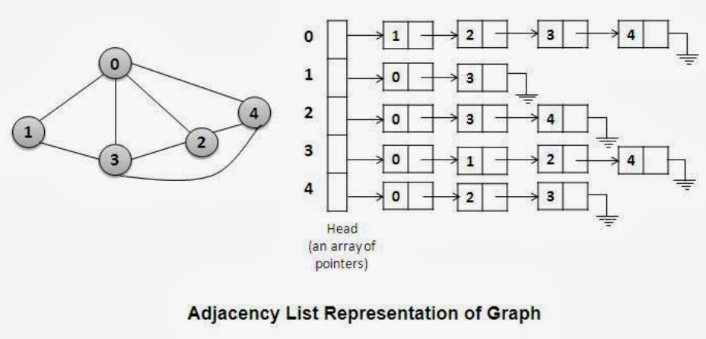
Linked Representation of Graph
14

Slide 17
Class Work
15
Let G be the unweighted undirected graph with 5 vertices. Represent it using Adjacency List
Let G’ be the unweighted directed graph with 5 vertices. Represent it using Adjacency List

Slide 18
Adjacency List vs. Adjacency Matrix
16
Adjacency Matrix
Adjacency List
Representation of graphs is very simple to implement.
Wastes lot of memory space. Such matrices are found to be very sparse. This representation requires space for n² elements for a graph with n vertices.
Degree of a vertex can easily be calculated by counting all non-zero entries in the corresponding row of the adjacency matrix.
Presence of an edge between two vertices V_{i} and V_{j} can be checked in constant time. if(adj[i][j] == 1) then edge is present between vertices i and j, else edge is absent between vertices i and j
Very memory efficient when the graph has a large number of vertices but very few edges.
For an undirected graph with n vertices and e edges, total number of nodes will be n + 2e. If e is large then due to overhead of maintaining pointers, adjacency list representation does not remain cost effective over adjacency matrix representation of a graph.
Degree of a node in an undirected graph is given by the length of the corresponding linked list.
Finding indegree of a directed graph represented using adjacency list will require O (e) comparisons. Lists pointed by all vertices must be examined to find the indegree of a node in a directed graph.
Checking the existence of an edge between two vertices i and j is also time consuming. Linked list of vertex i must be searched for the vertex j.

Slide 19
Graph Theory Application
17
Electrical Engineering − The concepts of graph theory is used extensively in designing circuit connections. The types or organization of connections are named as topologies. Some examples for topologies are star, bridge, series, and parallel topologies.
Computer Network − The relationships among interconnected computers in the network follows the principles of graph theory.
Science − The molecular structure and chemical structure of a substance, the DNA
structure of an organism, etc., are represented by graphs.
Linguistics − The parsing tree of a language and grammar of a language uses graphs.
General − Routes between the cities can be represented using graphs. Depicting hierarchical ordered information such as family tree can be used as a special type of graph called tree.
Computer Science − Graph theory is used for the study of algorithms. For example, Kruskal's Algorithm, Prim's Algorithm and Dijkstra's Algorithm

Slide 20
Graph Operation
18
Search a vertex and the edge between two vertices
Inserting a vertex
Inserting edges between two vertices
Deleting a vertex
Deleting edges between two vertices
Traversal
Breadth-First Search
Depth-First Search

Slide 21
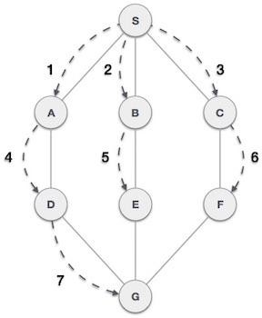
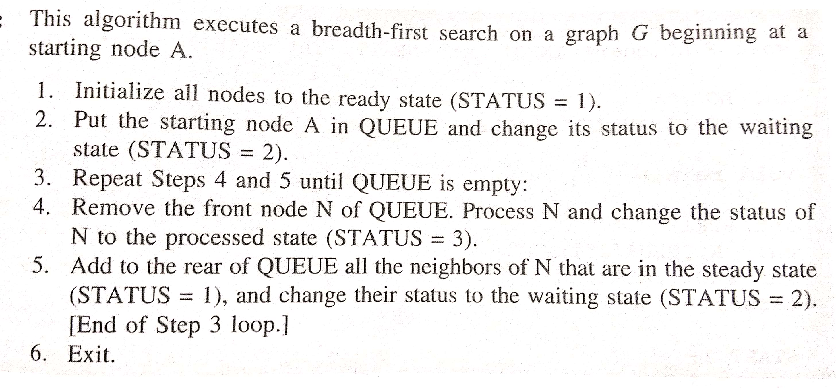
Breadth-First Search
1Breadth-First Search algorithm(BFS) traverses a graph in a breadth wards motion and uses a queue to remember to get the next vertex to start a search when a dead end occurs in any iteration.
Start
Algorithm

Slide 22
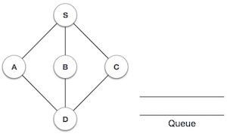
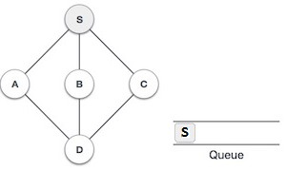
Breadth-First Search Example
20
Step # | Traversal | Description | O/P Seq
1 |  | Initialize the Queue | --
2 |  | We start from visiting S (starting node), and mark it visited and put it onto the queue | S

Slide 23
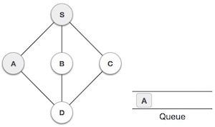
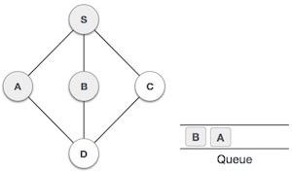
Breadth-First Search Example cont…
21
Step # | Traversal | Description | O/P Seq
3 |  | Queue is not empty and S is dequed. We then see unvisited adjacent node from S. In this example, we have three nodes but alphabetically we choose A mark it visited and enqueue it. | S, A
4 |  | Next unvisited adjacent node from S is B. We mark it visited and enqueue it. | S, A, B
Note: comma used in Output Sequence (i.e. O/P Seq) is for illustration

Slide 24
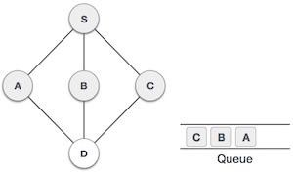
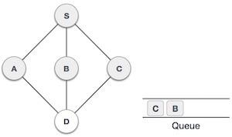
Breadth-First Search Example cont…
22
Step # | Traversal | Description | O/P Seq
5 |  | Next unvisited adjacent node from S is C. We mark it visited and enqueue it. | S, A, B, C
6 |  | Now S is left with no unvisited adjacent nodes. So we dequeue and find A. | S, A, B, C
Note: comma used in Output Sequence (i.e. O/P Seq) is for illustration

Slide 25
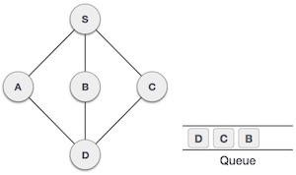
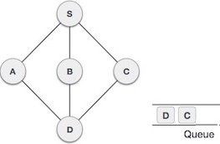
Breadth-First Search Example cont…
23
Step # | Traversal | Description | O/P Seq
7 |  | From A we have D as unvisited adjacent node. We mark it visited and enqueue it. | S, A, B, C, D
8 |  | At this stage we are left with no unmarked (unvisited) nodes. But as per algorithm we keep on dequeuing in order to get all unvisited nodes. When the queue gets emptied the algorithm is over. | S, A, B, C, D
Note: comma used in Output Sequence (i.e. O/P Seq) is for illustration

Slide 26
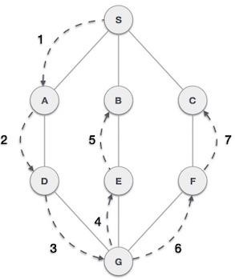
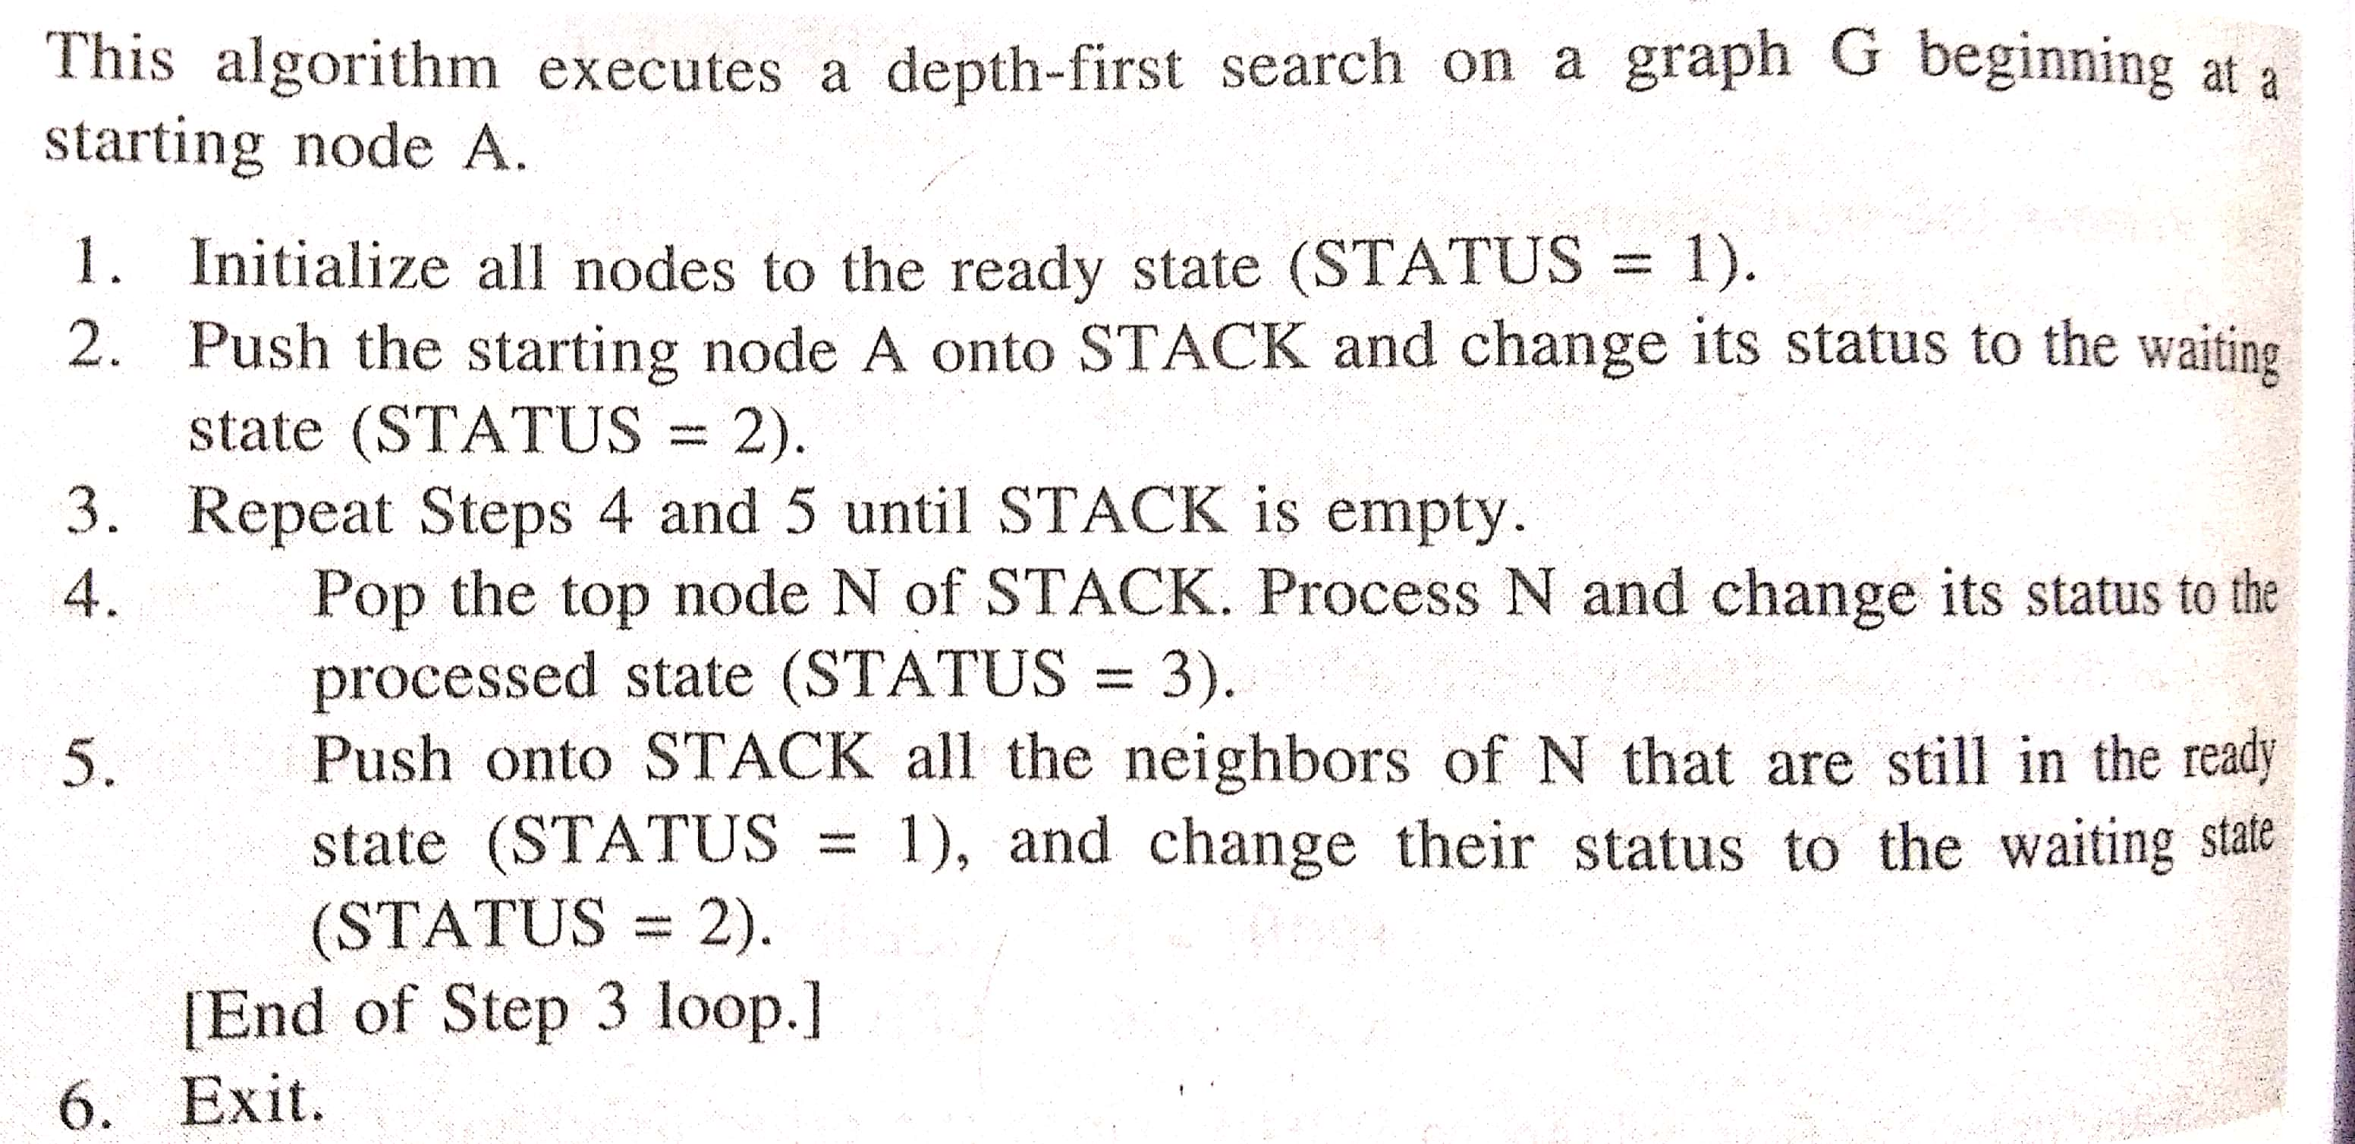
Depth-First Search
24
Depth-First Search algorithm(DFS) traverses a graph in a depth-ward motion and uses a stack to remember to get the next vertex to start a search when a dead end occurs in any iteration
Start
Algorithm

Slide 27
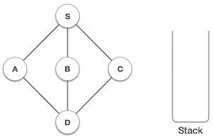
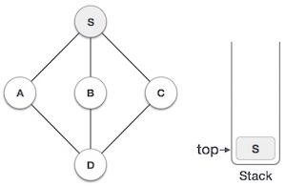
Depth-First Search Example
25
Step # | Traversal | Description | O/P Seq
1 |  | Initialize the stack | --
2 |  | Mark S as visited and put it onto the stack. Explore any unvisited adjacent node from S. We have three nodes and we can pick any of them. For this example, we shall take the node in alphabetical order. | S

Slide 28
Depth-First Search Example
26
Step # | Traversal | Description | O/P Seq
3 |  | Mark A as visited and put it onto the stack. Explore any unvisited adjacent node from A. Both S and D are adjacent to A but we are concerned for unvisited nodes only. | S, A
4 |  | Visit D and mark it visited and pop it from the stack. Here we have B and C nodes which are adjacent to D but both are already int the stack. | S, A, D
Note: comma used in Output Sequence (i.e. O/P Seq) is for illustration

Slide 29
Depth-First Search Example
27
Step # | Traversal | Description | O/P Seq
5 |  | We choose B, mark it visited and pop from the stack. Here B does not have any unvisited adjacent node. | S, A, D, B
6 |  | Now we check top of stack and found C, So process C and check its adjacent node. C does not have any unvisited node. Pop it from stack and now stack become empty. | S, A, D, B, C
Note: comma used in Output Sequence (i.e. O/P Seq) is for illustration

Slide 30
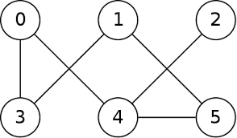
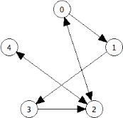
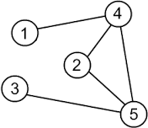
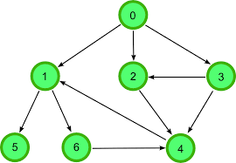
Class Work
29
Display O/P sequence using DFS and BFS method for each Graph
Start
Start
Start
Start

Slide 31
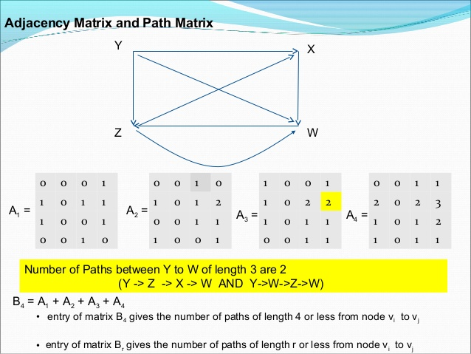
(2)
(1)
30
(3)
(4)

Slide 32
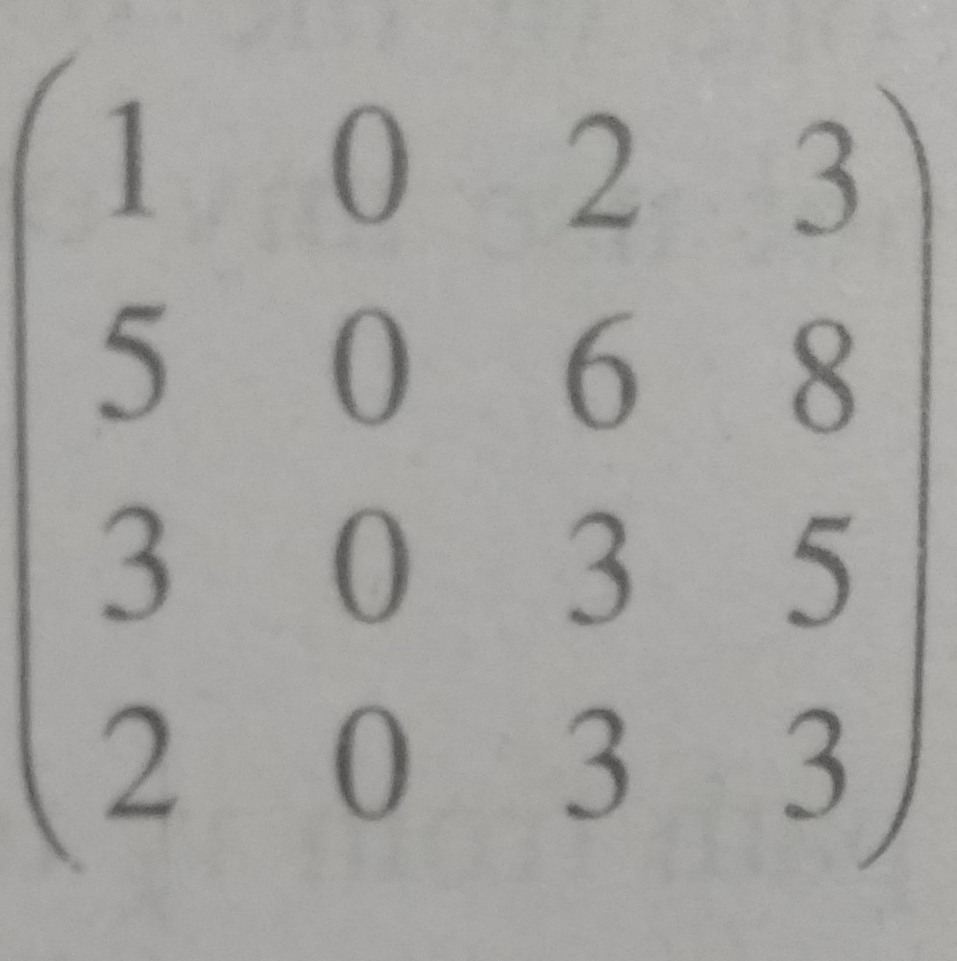
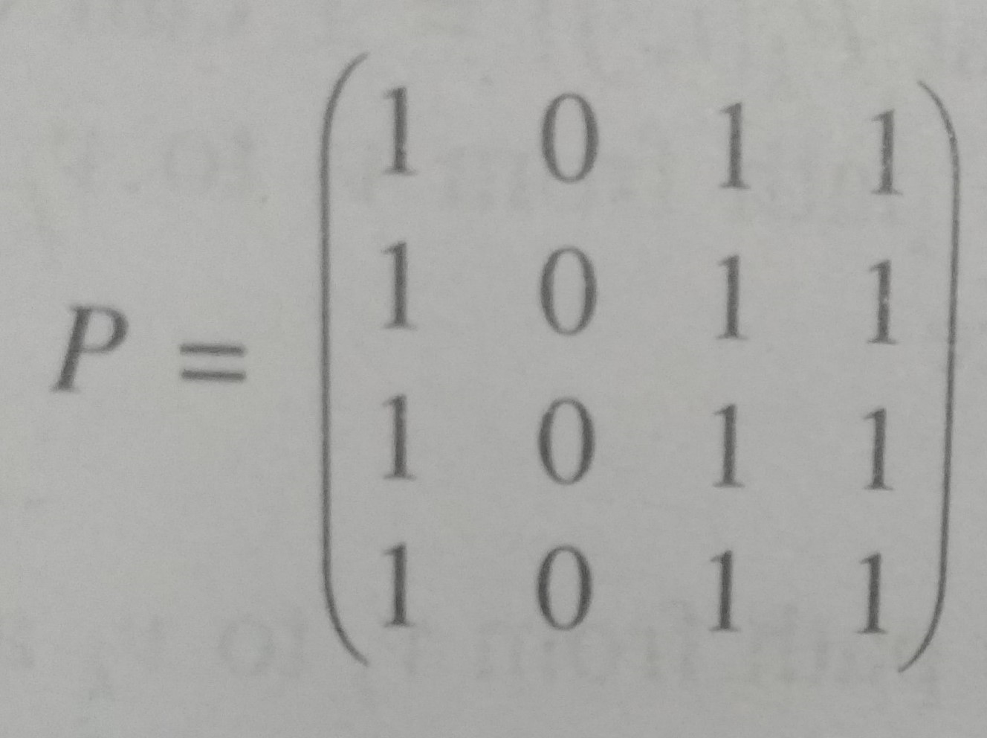
Path Matrix
31
Let G be a simple directed or undirected graph with 'm' nodes, v₁, v₂, ...., v_{m}.
The path matrix or reachability matrix of G is the m-square matrix P= (P_{ij}) defined as follows:
P_{ij}= 1 if there is a path from v_{i} to v_{j}
0 otherwise
Let A be the adjacency matrix and let P be the path matrix of a graph G. Then P_{ij}=1 iff there is a nonzero number in the ij entry of the matrix
B_{m}= A + A² + A³+ ... + A^{m}
B₄=
To find the path matrix, replace all nonzero numbers with 1.

Slide 33
Warshall's Algorithm
Let G be a directed graph with 'm' nodes, v₁, v₂, v₃, ..., v_{m}. Suppose we want to find the path matrix P of the graph G.
We have to define m-square Boolean matrices P₀, P₁, ..., P_{m} as follows.
Let P_{k}[i,j] denote the ij entry of the matrix P_{k}. Then we define:
P_{k}[i,j]= 1 if there is a simple path from v_{i} to v_{j} which does not use any
other nodes except possibly v₁, v₂, ...., v_{k}
0 otherwise

Slide 34
Warshall's Algorithm

Slide 35
Warshall's Algorithm

Slide 36
Dijskatra's Algorithm (Shortest-Path)
Let G be a directed graph with 'm' nodes, v₁, v₂, v₃, ..., v_{m}. Suppose G is weighted (nonnegative) graph with w(e) called the weight or length of the edge 'e'.
Weight matrix W = (w_{ij}), which is defined as:
w_{ij}= w(e) if there is an edge e from v_{i} to v_{j}
0 if there is no edge from v_{i} to v_{j}
Next, we define a sequence of matrices Q₀, Q₁, ... , Q_{m} whose entries are defined as follows:
Q_{k}[i,j] = the smaller of the length of the preceding path from v_{i} to vj OR
the sum of the lengths of the preceding paths from v_{i} to v_{k} and
from v_{k} to v_{j}
Formula: Q_{k}[i,j] = MIN ( Q_{k-1}[i,j], Q_{k-1} [i,k] + Q_{k-1} [k,j]

Slide 37
Dijskatra's Algorithm (Shortest-Path)

Slide 38
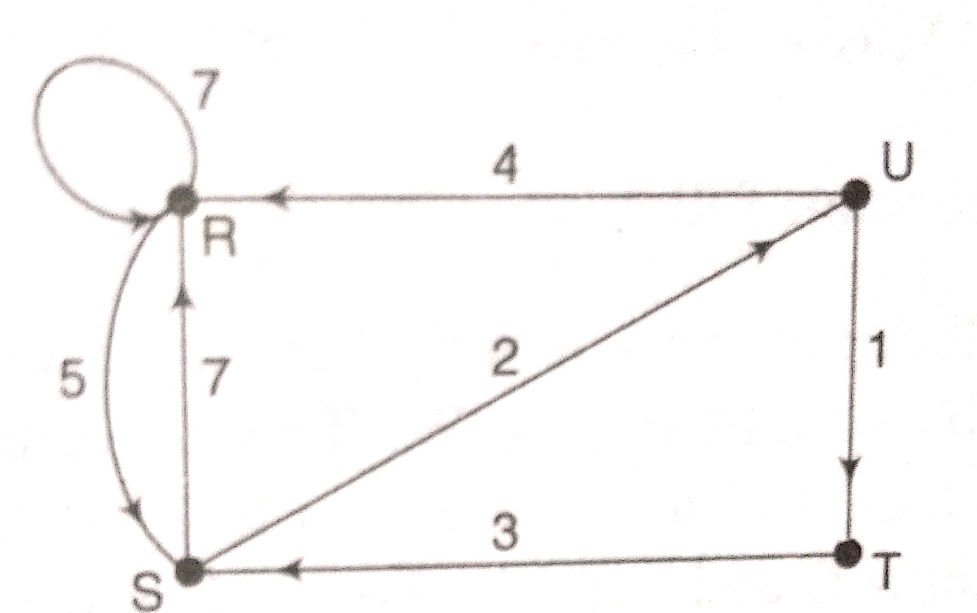
Dijskatra's Algorithm (Shortest-Path)

Slide 39
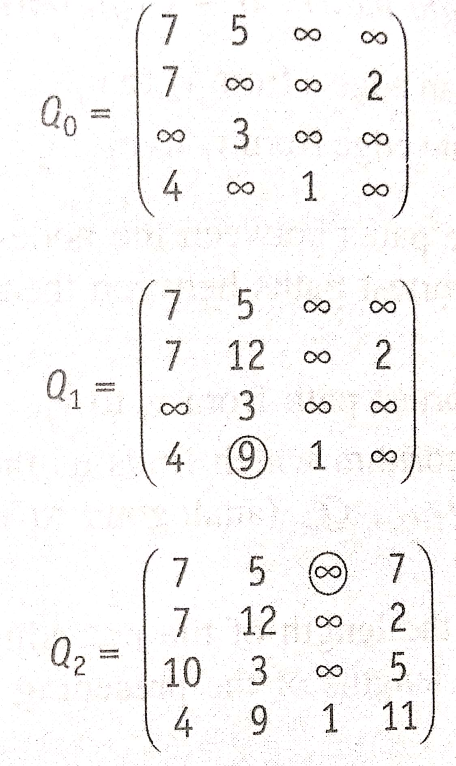


Dijskatra's Algorithm (Shortest-Path)

Slide 40



FAQ
34
Describe Graphs with example.
Graphs are widely-used structure in computer science and different computer applications. Graphs mean to store and analyze metadata, the connections, which present in data. For instance, consider cities in a country. Road network, which connects them, can be represented as a graph and then analyzed. We can examine, if one city can be reached from another one or find the shortest route between two cities. There are two important sets of objects, which specify graph and its structure. First set is V, which is called vertex-set. In the example with road network cities are vertices. Each vertex can be drawn as a circle with vertex's number inside. Next important set is E, which is called edge-set. E is a subset of V x V. Simply speaking, each edge connects two vertices, including a case, when a vertex is connected to itself (such an edge is called a loop). All graphs are divided into two big groups: directed and undirected graphs. The difference is that edges in directed graphs, called arcs, have a direction. These kinds of graphs have much in common with each other, but significant differences are also present. We will accentuate which kind of graphs is considered in the particular algorithm description. Edge can be drawn as a line. If a graph is directed, each line has an arrow.
Vertices
Undirected Graph
Directed Graph

Slide 41
FAQ
35
BFS:
BFS is a traversing algorithm where you should start traversing from a selected
DFS:
The DFS is a recursive algorithm uses the idea of backtracking. It involves exhaustive searches of all the nodes by going ahead, if possible, else by backtracking.
Here, the word backtrack means that when you are moving forward and there are no more nodes along the current path, you move backwards on the same path to find nodes to traverse. All the nodes will be visited on the current path till all the unvisited nodes have been traversed after which the next path will be selected.
This recursive nature of DFS can be
implemented using stacks.
node (source or
traverse the
starting node) and
thus exploring the neighbor nodes (nodes
graph layer-wise
which are directly connected to source node). You must then move towards the next-level neighbor nodes.
As the name BFS suggests, you are required to traverse the graph breadth- wise.
It uses a queue to remember to get the next vertex to start a search when a dead end occurs in any iteration

